Slide 1

Post Merger Integration Toolkit Overview and Approach
Confidential
Created by ex-McKinsey, Deloitte & BCG Strategy Consultants

Slide 2
Context The advantages & disadvantages of an organic growth strategy
Description
Advantages
Disadvantages
Organic Growth Strategy
Often perceived as the default growth option for companies, an organic growth strategy relies on developing a company’s internal resources and capabilities
Provides deeper first-hand knowledge that is likely to be internalized in the company
Helps spread investment over time and reduce upfront commitment
There are no availability constraints, that is to say that the company is not dependent on the availability of suitable acquisition targets or potential alliance partners
Strategic independence
Creation of new activities within the existing culture environment
Can be slow, expensive, and risky
Difficult to use existing capabilities as the platform for major leaps in terms of innovation, diversification, or internationalization

Slide 3
Context The advantages & disadvantages of a Mergers and Acquisitions (M&A) Strategy.
Description
Advantages
Disadvantages
Mergers and Acquisitions Strategy
Mergers and acquisitions (M&A) bring together companies through complete changes in ownership. They have been used by companies for centuries and remain a major way for companies to expand rapidly
Business extension: M&A can be used to extend the reach of a firm in terms of geography, products, or markets
Building capabilities: M&A may increase a company’s capabilities
Increase market power by reducing competition and increasing bargaining power with suppliers
Increase efficiency: by sharing resources and capabilities
Speed: M&A allows acquirers to act fast
Financial efficiency: by combining the 2 balance sheets
Tax efficiency
Important investment upfront
Potential culture clash between the 2 companies
High failure rate
Sometimes excessive initial valuations, exaggerated expectations of strategic fit, and underestimated problems of organizational fit

Slide 4






The M&A life cycle includes 6 phases:
I. Define your M&A Strategy
II. Identify Target Companies
III. Build a Business Case and Financial Modeling
IV. Conduct Due Diligence
V. Execute Transaction
VI. Conduct the Post Merger Integration

Slide 5
Main problem of the M&A strategy More than half of M&As fail to reach their value creation objectives
*Consolidation of multiple surveys from New York Times, Harvard Business Review, and Australia Financial Review

Slide 6
Root cause of the problem A poorly managed post merger integration phase is responsible for more than half of the failures of M&As.
*Consolidation of multiple surveys from New York Times, Harvard Business Review and Australian Financial Review

Slide 7








Traditional Solution To solve this problem, companies usually hire management consultants from tier-1 management consulting firms. While this solution works well, not everyone can afford it.
To help them increase the value creation of their M&As, most tier-one companies (e.g. Apple, Procter & Gamble, Google, Amazon) are hiring management consultants from the following management consulting firms:
While this solution usually brings a tremendous return on investment, not every business can afford to spend $300k+ to hire of couple of McKinsey, Deloitte or BCG Management Consultants.

Slide 8







Our Solution Our management consulting firm decided to create an affordable Post Merger Integration Toolkit that will help you increase the value creation of the mergers & acquisitions of your organization (or your client if you are a management consultant).
Best Practices
Frameworks
What’s inside our Toolkit?
Advice from
tier-1 Management Consultants
Tools
Real-life Examples
Templates
Video Training
Step-by-step Tutorials

Slide 9
Objectives The Post Merger Integration Toolkit includes frameworks, tools, templates, tutorials, real-life examples, video training and best practices to help you:
Conduct a post merger integration to ensure the company reaches its cost and revenue synergy targets
Increase the value creation of your mergers & acquisitions with a simple and comprehensive 3-phase approach: (I) Strategy & high-level plan, (II) Detailed plans, (III) Implementation & monitoring
(I) Define & communicate your post merger acquisition strategy & high-level plan: (1) Merger strategic objectives, (2) Integration management office, (3) Guiding principles, (4) Post merger integration high-level plan, (5) Top layer organizational structure, (6) Top management appointment, (7) Training to help managers set up their team, (8) Integrated synergy baseline, (9) Synergy targets, (10) Potential integration & synergy initiatives, (11) Business cases and financial models, (12) Integration & synergy initiatives prioritization
(II) Develop & communicate the detailed plans: (1) Detailed integration plan including the Day 1 readiness checklist, (2) Integration & synergy initiatives plan, (3) Change management strategy and plan, (4) Communication strategy and plan, (5) Culture integration strategy and plan, (6) Risk management strategy and plan, (7) Staffing & retention plan
(III) Implement and monitor the post merger integration high-level plan and detailed plans: (1) High-level plan status, (2) Detailed plans status, (3) Integration lessons learned, (4) Institutionalization of the updated PMI Toolkit
Become the post merger integration subject matter expert of your organization

Slide 10



3-phase approach The Post Merger Integration Toolkit includes a 3-phase approach that we have built and refined over the past 20 years through constant trial and error. The good news is that you don’t have to waste your time, energy, and money going through that lengthy trial-and-error process. You can simply leverage our work and customize it based on the specificities of your organization.
Phase I: Define & Communicate the Strategy & High-Level Plan
Phase II: Develop & Communicate the Detailed Plans
Phase III: Implement & Monitor
Merger strategic objectives
Integration management office
Guiding principles
Post merger integration high-level plan
Organizational structure (Top layers)
Top management appointment
Training to help managers set up their team
Integrated synergy baseline
Synergy targets
Potential integration & synergy initiatives
Business cases and financial models
Integration & synergy initiatives prioritization
Detailed integration plan including the Day 1 readiness checklist
Integration & synergy initiatives plan
Change management strategy and plan
Communication strategy and plan
Culture integration strategy and plan
Risk management strategy and plan
Staffing & retention plan
Status of the post-merger integration high-level plan
Status of the detailed integration plan
Status of the integration and synergy initiatives plan
Status of the change management strategy and plan
Status of the communication strategy and plan
Status of the culture integration strategy and plan
Status of the risk management strategy and plan
Status of staffing and the retention plan
Integration lessons learned
Institutionalization of the updated PMI Toolkit

Slide 11
In the next slides, you’ll see a small preview of Phase I
Phase I: Define & Communicate the Strategy & High-Level Plan
Phase II: Develop & Communicate the Detailed Plans
Phase III: Implement & Monitor
Merger strategic objectives
Integration management office
Guiding principles
Post merger integration high-level plan
Organizational structure (Top layers)
Top management appointment
Training to help managers set up their team
Integrated synergy baseline
Synergy targets
Potential integration & synergy initiatives
Business cases and financial models
Integration & synergy initiatives prioritization
Detailed integration plan including the Day 1 readiness checklist
Integration & synergy initiatives plan
Change management strategy and plan
Communication strategy and plan
Culture integration strategy and plan
Risk management strategy and plan
Staffing & retention plan
Status of the post-merger integration high-level plan
Status of the detailed integration plan
Status of the integration and synergy initiatives plan
Status of the change management strategy and plan
Status of the communication strategy and plan
Status of the culture integration strategy and plan
Status of the risk management strategy and plan
Status of staffing and the retention plan
Integration lessons learned
Institutionalization of the updated PMI Toolkit

Slide 12

The strategic objectives of our merger are:
Template
Don’t reinvent the wheel here. Most of the strategic objectives should have already been written prior to the deal.
1
Replace this text with your own text
2
Replace this text with your own text
3
Replace this text with your own text
4
Replace this text with your own text
5
Replace this text with your own text
6
Replace this text with your own text

Slide 13
The most common strategic objectives of mergers are:
Example
Example we used during a PMI consulting project we did for a Global Fortune 1000 firm.
1
Gaining economies of scale
2
Entering a new country
3
Entering a new market
4
Increasing the company’s product or service portfolio
5
Increasing market share by acquiring one of your competitors (horizontal integration)
6
Becoming a key player in an industry by acquiring one of your suppliers or clients (vertical integration)

Slide 14
We decided to create an Integration Management Office that will be responsible for the success of the integration
The Integration Management Office will oversee the post Merger Integration and be responsible for its success. It includes 7 [replace this number with your own number] executives representing both [insert name of the acquiring company] and [insert name of the acquired company]:
This is only an example. You may decide to emphasize different areas and adjust the size of the integration Management Office.
Integration Management Officer
[Insert name]
Integration and Synergy Initiatives
[Insert name]
Change Management
[Insert name]
Communication
[Insert name]
Culture
[Insert name]
Risk Management
[Insert name]
Training
[Insert name]

Slide 15
We identified 8 [insert your own number] guiding principles for post merger integration
Template
1
Insert your own guiding principle
2
Insert your own guiding principle
3
Insert your own guiding principle
4
Insert your own guiding principle
5
Insert your own guiding principle
6
Insert your own guiding principle
7
Insert your own guiding principle
8
Insert your own guiding principle

Slide 16
Top 8 commonly used guiding principles for post merger integration
Example
Example we used during a PMI consulting project we did for a Global Fortune 1000 firm.
1
Be clear on the strategic objectives of the deal
2
Ground the integration in the objectives of the deal
3
Be clear on your synergy baseline and targets
4
Create a robust integration plan to reach the strategic objectives of the deal and the synergy targets
5
Search for synergies in every function of the newly created organization
6
Communicate on a regular basis to all stakeholders
7
Ensure cultural fit
8
Maintain business momentum

Slide 17
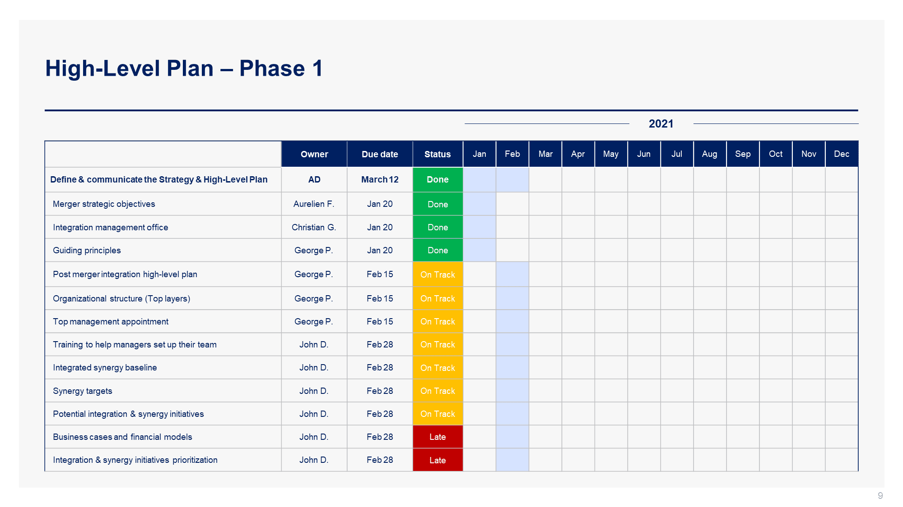
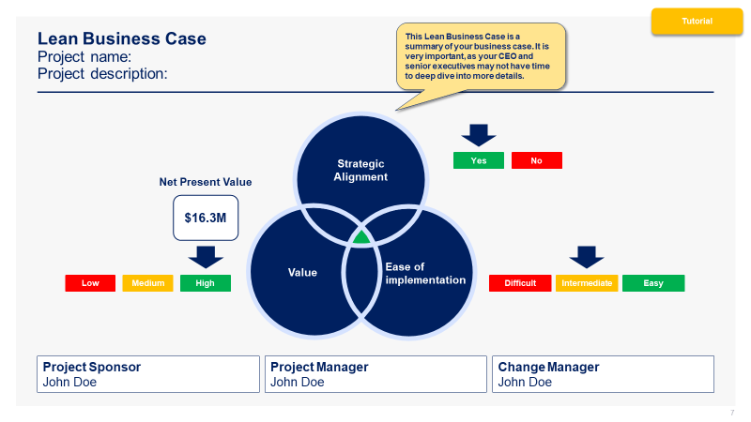
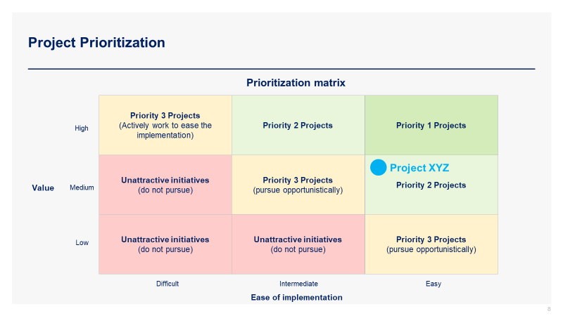
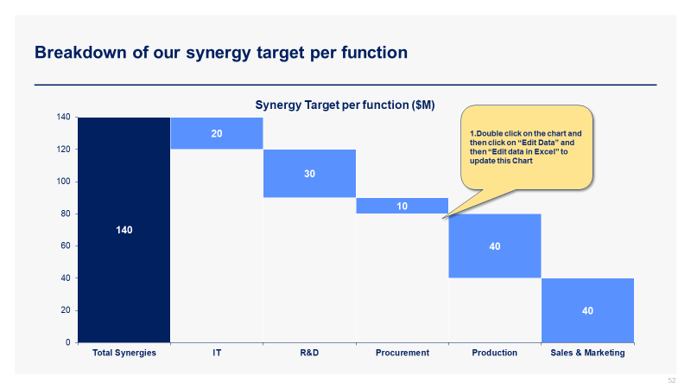
See below 4 screenshots from Phase I.
Screenshots
High-Level Plan
Lean Business Case
Prioritization Matrix
Synergy Target Breakdown

Slide 18
In the next slides, you’ll see a small preview of Phase II.
Phase I: Define & Communicate the Strategy & High-Level Plan
Phase II: Develop & Communicate the Detailed Plans
Phase III: Implement & Monitor
Merger strategic objectives
Integration management office
Guiding principles
Post merger integration high-level plan
Organizational structure (Top layers)
Top management appointment
Training to help managers set up their team
Integrated synergy baseline
Synergy targets
Potential integration & synergy initiatives
Business cases and financial models
Integration & synergy initiatives prioritization
Detailed integration plan including the Day 1 readiness checklist
Integration & synergy initiatives plan
Change management strategy and plan
Communication strategy and plan
Culture integration strategy and plan
Risk management strategy and plan
Staffing & retention plan
Status of the post-merger integration high-level plan
Status of the detailed integration plan
Status of the integration and synergy initiatives plan
Status of the change management strategy and plan
Status of the communication strategy and plan
Status of the culture integration strategy and plan
Status of the risk management strategy and plan
Status of staffing and the retention plan
Integration lessons learned
Institutionalization of the updated PMI Toolkit

Slide 19
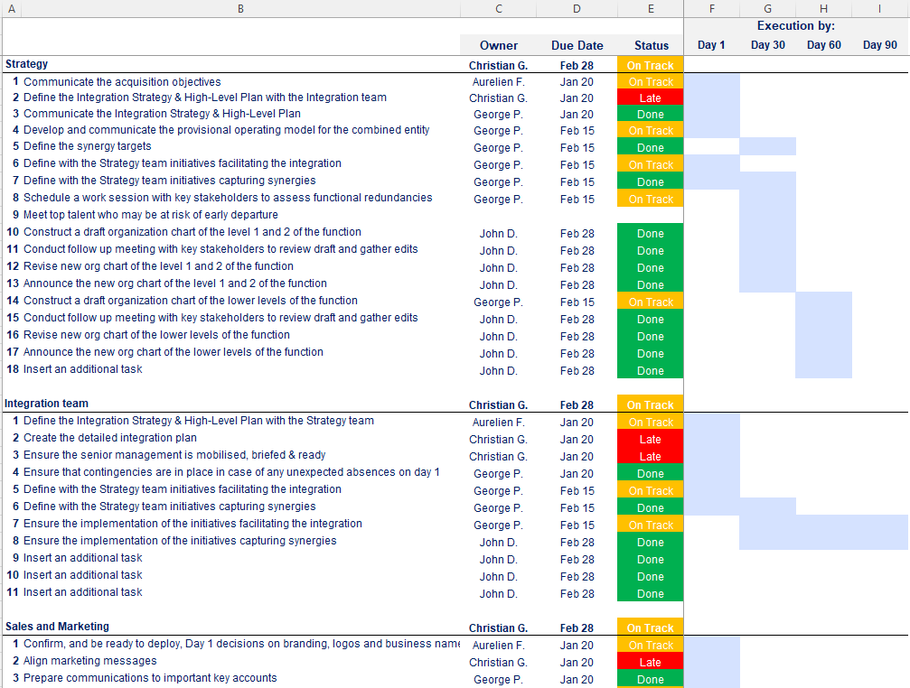
Detailed integration plan including the Day 1 readiness checklist
Open the Excel document “Detailed Integration Plan” to see the 300+ activities listed in the plan

Slide 20
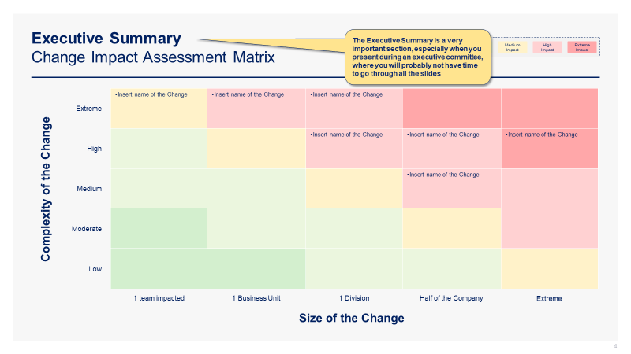
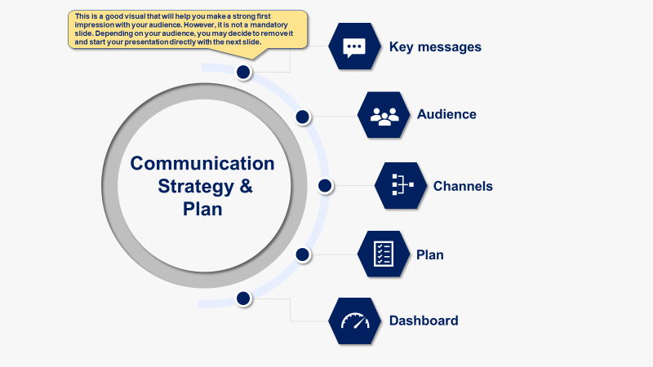
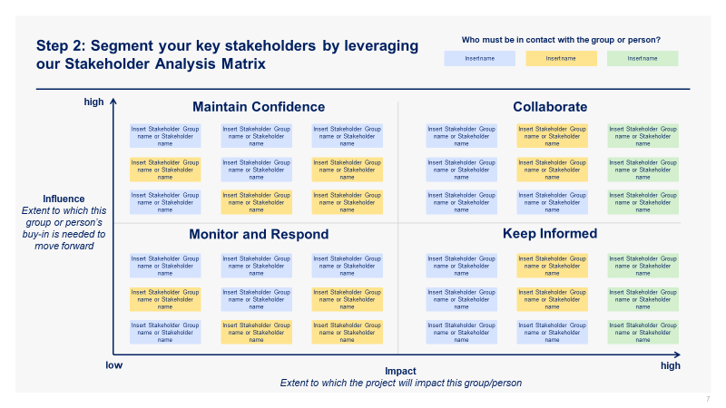
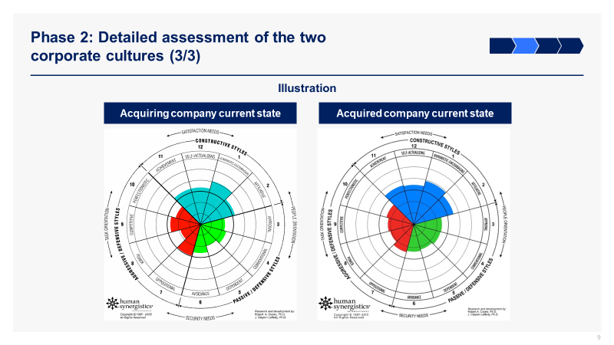
See below 4 additional screenshots from Phase II.
Screenshots
Change Impact Assessment Matrix
Communication Strategy & Plan
Stakeholder Analysis Matrix
Culture Integration Strategy

Slide 21
In the next slides, you’ll see a small preview of Phase III.
Phase I: Define & Communicate the Strategy & High-Level Plan
Phase II: Develop & Communicate the Detailed Plans
Phase III: Implement & Monitor
Merger strategic objectives
Integration management office
Guiding principles
Post merger integration high-level plan
Organizational structure (Top layers)
Top management appointment
Training to help managers set up their team
Integrated synergy baseline
Synergy targets
Potential integration & synergy initiatives
Business cases and financial models
Integration & synergy initiatives prioritization
Detailed integration plan including the Day 1 readiness checklist
Integration & synergy initiatives plan
Change management strategy and plan
Communication strategy and plan
Culture integration strategy and plan
Risk management strategy and plan
Staffing & retention plan
Status of the post-merger integration high-level plan
Status of the detailed integration plan
Status of the integration and synergy initiatives plan
Status of the change management strategy and plan
Status of the communication strategy and plan
Status of the culture integration strategy and plan
Status of the risk management strategy and plan
Status of staffing and the retention plan
Integration lessons learned
Institutionalization of the updated PMI Toolkit

Slide 22


To ensure proper execution of the integration and synergy initiatives, it is very important to appoint high-caliber initiative owners or project managers
The main challenge for the different initiative owners or project managers will be to meet the objectives while balancing the triple constraints of quality, cost, and time
✓
Quality
Meeting the expectations
Completing the project in a specific time of frame
Project Manager
Managing a budget and resource limitations
Time
Cost

Slide 23
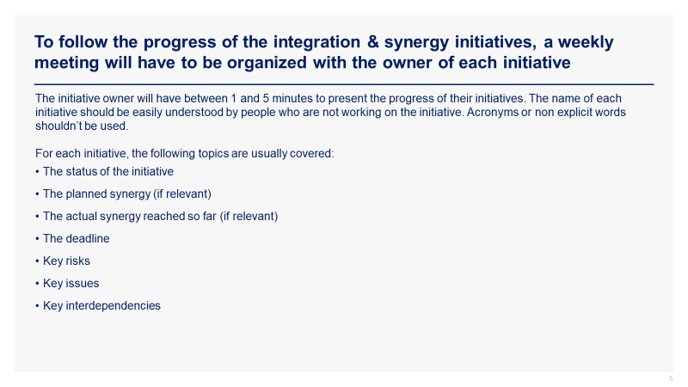
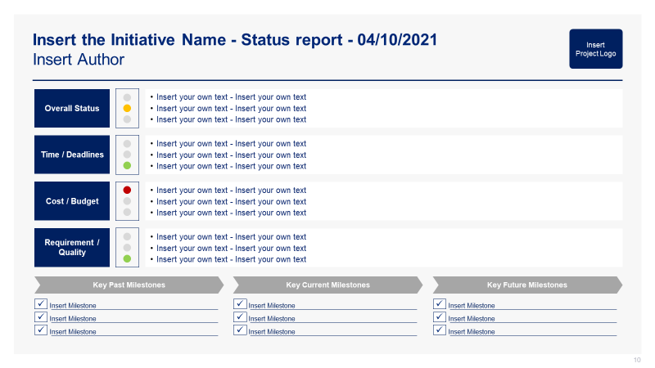
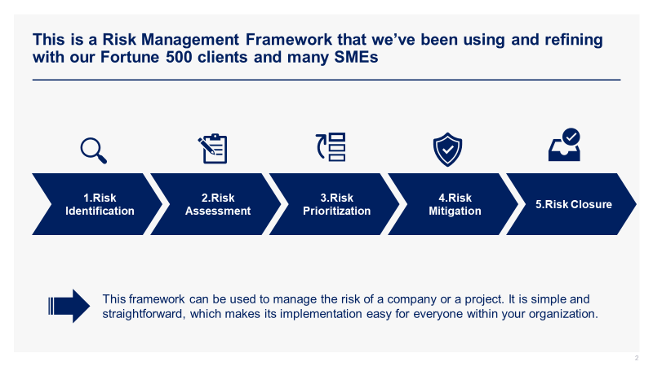
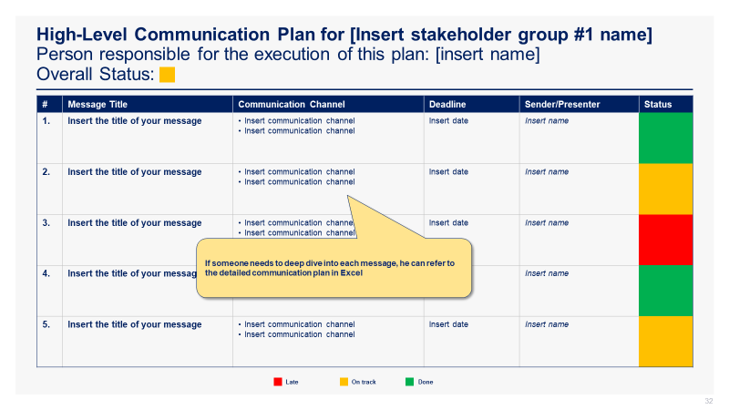
See below 4 additional screenshots from Phase III.
Screenshots
Governance
Initiative Status Report
Risk Management Framework
Communication Plan

Slide 24

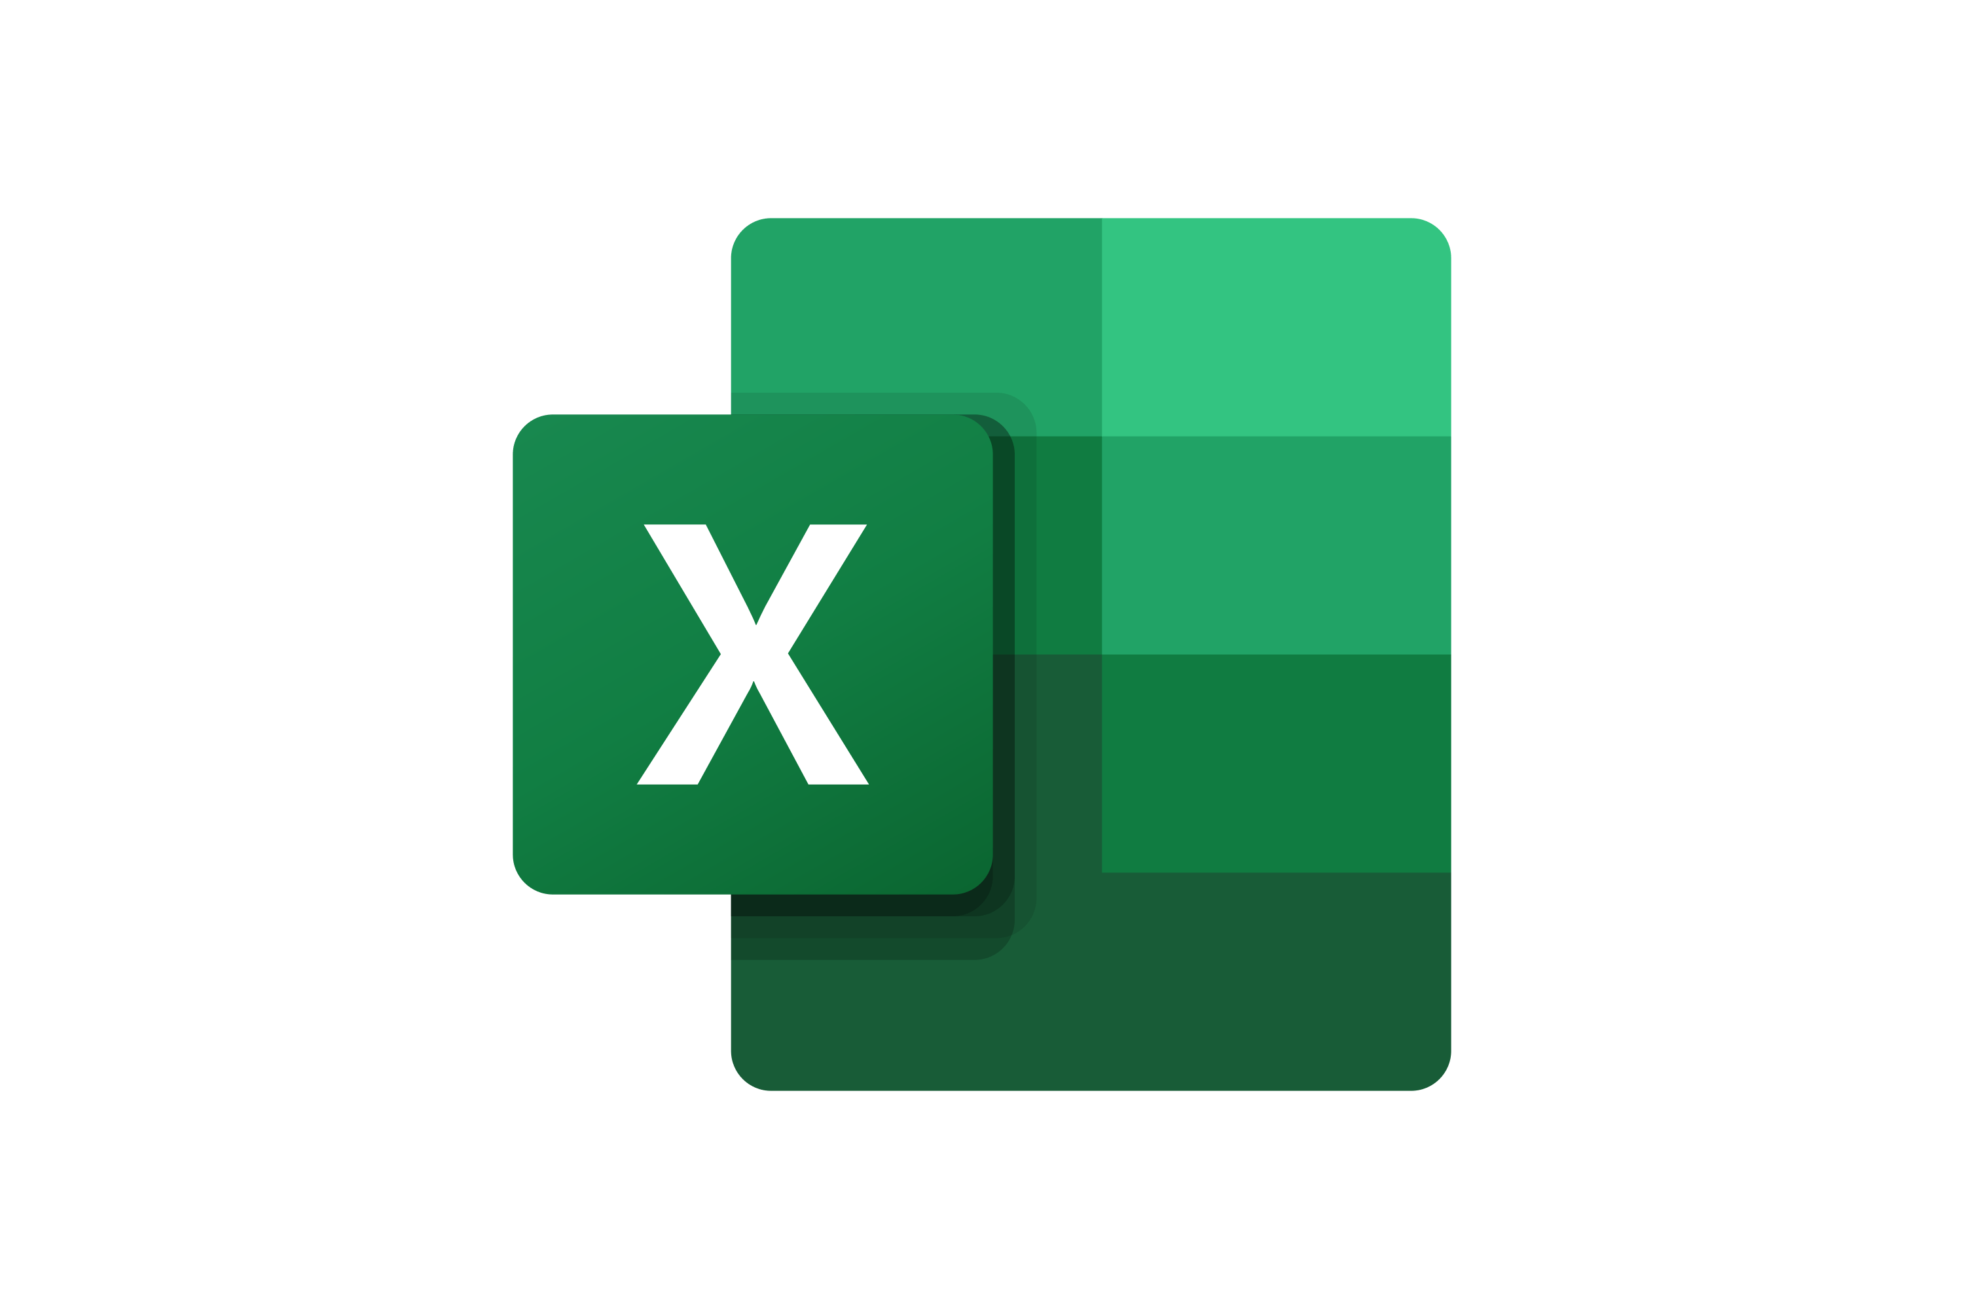



Structure of the Toolkit The Post Merger Integration Toolkit includes 300 Powerpoint slides, 30 Excel sheets and 37 minutes of video training organized into 4 folders that you can download on your device immediately after your purchase.
+
+
300 editable Powerpoint slides*
30 editable Excel sheets*
37 minutes of Video training
1
2
3
4
Overview and 3-phase approach
Phase I - Define & Communicate the Strategy & High-Level Plan
Phase II - Develop & Communicate the Detailed Plans
Phase III - Implement & Monitor
*Please note that the number of PowerPoint slides and Excel sheets listed is the number of unique slides and sheets. For example, a PowerPoint slide that has been duplicated to facilitate our clients’ understanding only counts for 1 slide.

Slide 25









Key Benefits of our Management Consulting Toolkits
Improve the growth & efficiency of your organization by leveraging Management Consulting Toolkits created by ex-McKinsey, Deloitte & BCG Consultants.
Make a great investment for your career & organization. It cost us US$8M+ over the past 10 years to create all our Toolkits. Get them for a fraction of this cost.
Get a competitive advantage. It’s like hiring Management Consultants to create all the practical Frameworks, Tools & Templates you need.
Get the job done quicker and never start from scratch again with our ready-made and fully editable Frameworks, Tools & Templates in Powerpoint & Excel.
Don't reinvent the wheel. We have already worked 30,000+ hours over the past 10 years to create all the Management Consulting Toolkits you need.
Improve the capabilities of your organization by learning how the Fortune 100 and Global Consulting Firms do it.
Decrease your costs. Hiring tier-1 Consultants for a project would cost you $300k+. Way more expensive than our Toolkits, which will last you a lifetime!
Become your organization’s subject matter expert and impress your stakeholders with world-class approaches to resolve common business problems.
Get free support and advice from our ex-McKinsey, Deloitte & BCG Management Consultants.

Slide 26
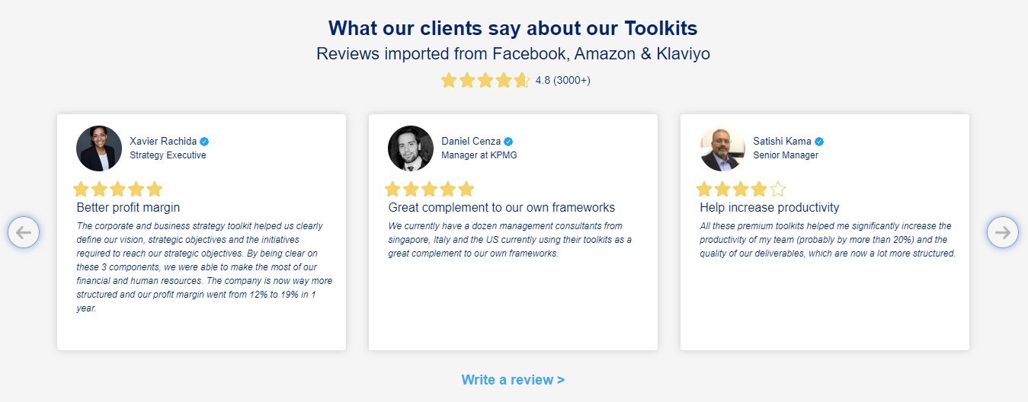
What our clients say about our Toolkits Reviews imported from Facebooks, Amazon and Klaviyo
See more reviews >

Slide 27

Join the 200,000+ Executives, Consultants & Entrepreneurs already leveraging our Business & Consulting Toolkits to improve the performance of their organization and boost their own career.
Trusted by small and large organizations
Customer satisfaction
4.8
Number of countries leveraging our Business & Consulting Toolkits
160+
Number of professionals leveraging our Business & Consulting Toolkits
200,000+
Daily rate of our ex-McKinsey, Deloitte and BCG Management Consultants
$3k-$4k

Slide 28

Interested in more than 1 Toolkit? Access all our Toolkits for half the price with our Gold Access
Gold Access
Click here to learn more

Slide 29
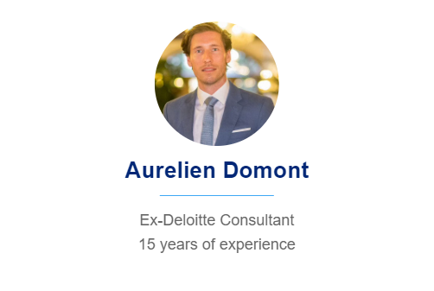
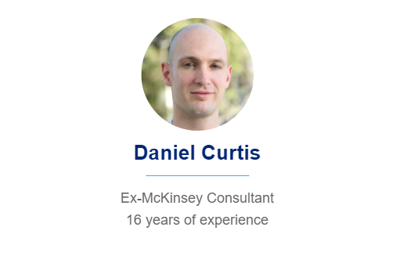
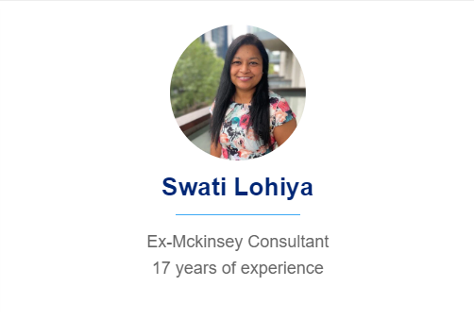
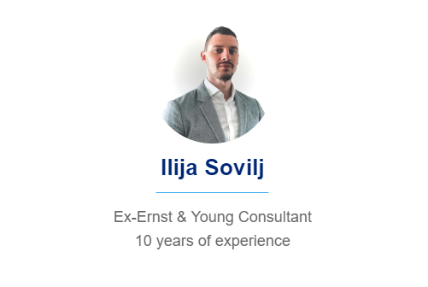
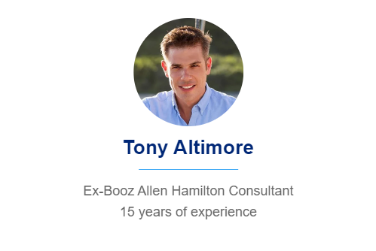
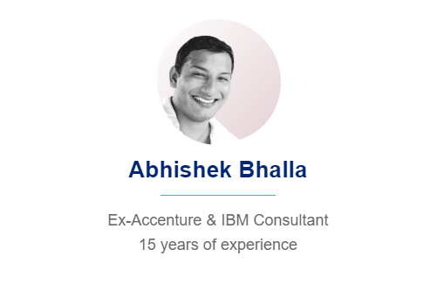
Need additional help on top of our Management Consulting Toolkits? Send us a brief and we’ll find you the right talent from our network of 500 tier-1 Management Consultants (the average daily rate is $3k)
Click here to send us a Project Brief

Slide 30

Thank you for your attention.
www.domontconsulting.com

